Slide 1
Center overview

Slide 2
Mission
To improve human health by establishing evolutionary biology as an essential basic science for medicine, worldwide.

Slide 3
Core Faculty

Slide 4
Staff
Director—Randolph Nesse
Associate Director—Anne Stone
Assistant Director—Jennifer Vazquez
Education Programs Coordinator Sr.—Lenora Ott
Business Operations Specialist—Jackie Smith
Communications & Events Coordinator– Jason Krell
Web Developer - Suhail Ghafoor
Communications & Office Assistant – Navinkumar Krishnan

Slide 5
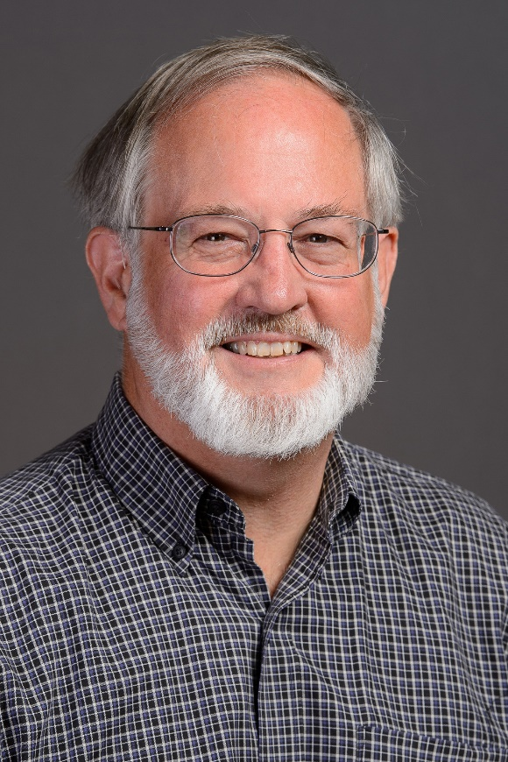
Randolph Nesse
Founding Director
Center for Evolution & Medicine
Professor of Life Sciences
Foundation Professor
Current research
Physiological regulation systems vulnerable to failure because of asymmetric fitness landscapes or positive feedback causing chronic pain, anxiety, & depression

Slide 6
Anne Stone
Associate Director
Center for Evolution & Medicine
Professor, School of Human Evolution & Social Change
Regents’ Professor
National Academy of Sciences member
Current research
Anthropological genetics, focusing on population history and understanding how humans and the great apes have adapted to their environments, including their disease and dietary environments.

Slide 7
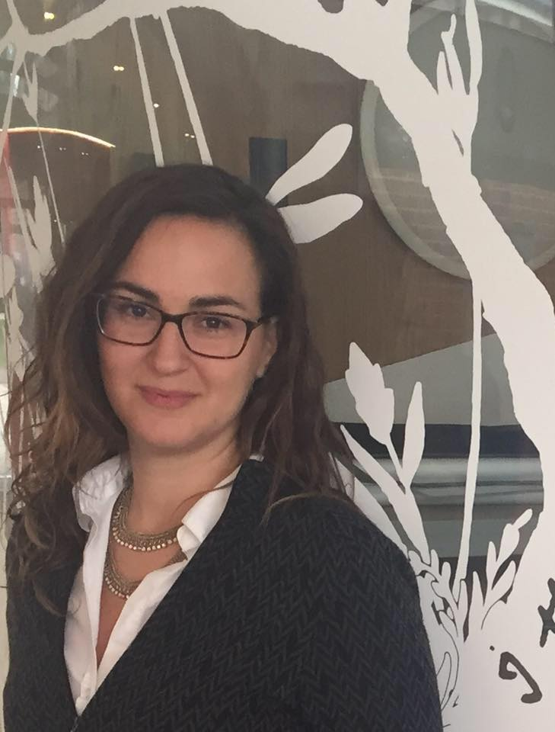
Athena Aktipis
Assistant Professor
Department of Psychology
Co-Director,
Human Generosity Project
Current Research
Cooperation and conflict in biological systems including cancer evolution and the human microbiome.

Slide 8
Sara Brownell
Assistant Professor
School of Life Sciences
Current research
Integrating teaching and research in the context of course-based undergraduate research experiences. Developing tools for biology departments to more effectively teach core concepts in biology. Making evolution courses more inclusive for all students

Slide 9
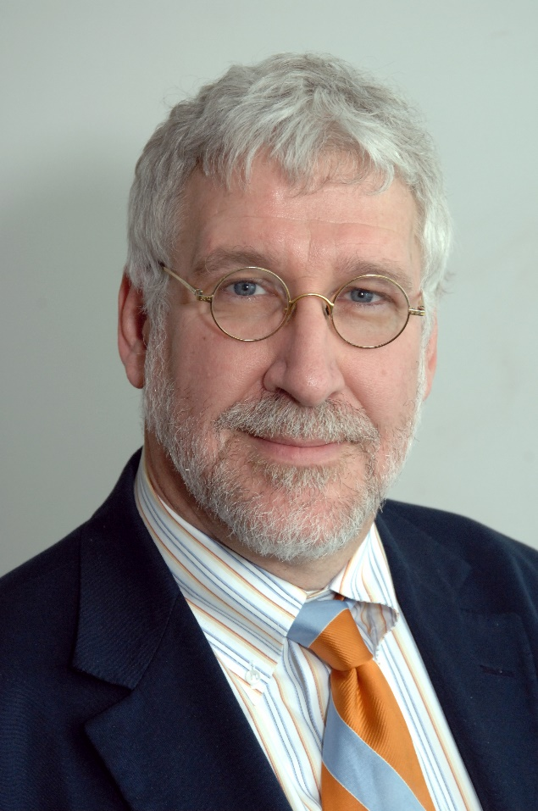
Kenneth Buetow
Professor
School of Life Sciences
Director, Computational Sciences and Informatics program for Complex Adaptive Systems
Current research
Functional genomics and bioinformatics to understand complex traits such as cancer, liver disease, and obesity.

Slide 10
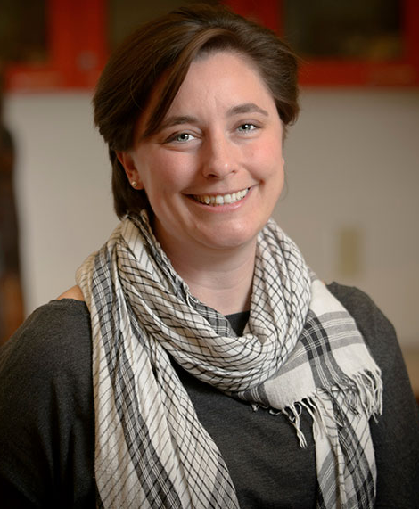
Katie Hinde
Associate Professor
School of Human Evolution & Social Change
Current research
Lactation science looking at how variation in mother’s milk and behavioral care influences infant outcomes.

Slide 11
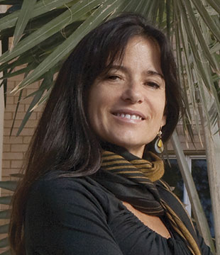
Magdalena Hurtado
Professor
School of Human Evolution & Social Change
Current research
Mortality reduction mechanisms in humans with emphasis on cultural niche construction and innate immunity.

Slide 12
Jeffrey D. Jensen
Professor
School of Life Sciences
Current research
Developing theory and statistical methodology for describing and quantifying adaptation in natural and experimental populations

Slide 13
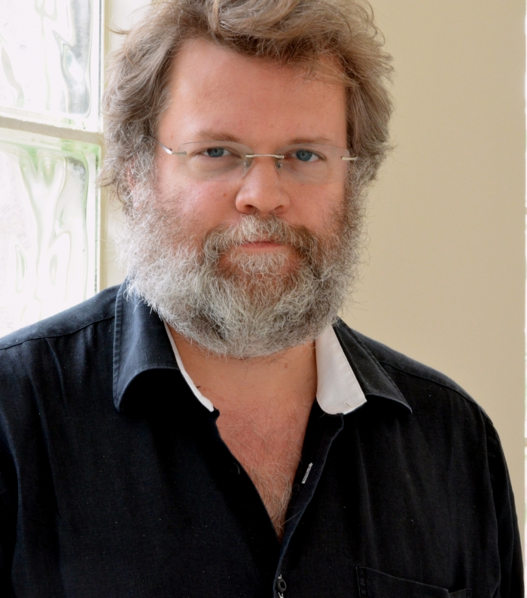
Manfred Laubichler
Professor
School of Life Sciences
Director, ASU-Santa Fe Institute
The Center for Biosocial Complex Systems
Associate Director, Origins Project ASU
Current research
Theoretical biology and history of science, evolutionary biology and complex adaptive systems.

Slide 14
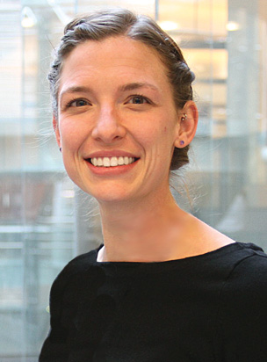
Melissa Wilson Sayres
Assistant Professor
School of Life Sciences
Current research
The evolution of sex chromosomes (X and Y in mammals), why mutation rates differ between males and females, and how changes in population history affect the sex chromosomes differently than the non-sex chromosomes. Wilson Sayres is also active in public science engagement and outreach.

Slide 15
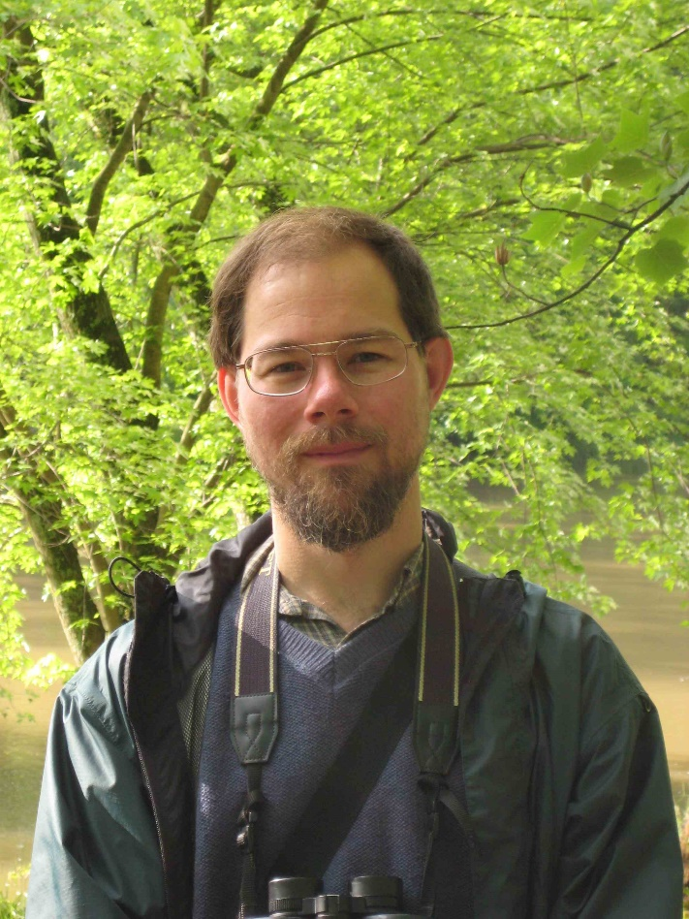
Jay Taylor
Associate Professor
School of Life Sciences
School of Mathematical and Statistical Sciences
Current Research
Using both mathematical models and genetic sequence analysis to understand how populations evolve in complex and changing environments. He is particularly interested in the evolution of parasites that cause chronic infectious diseases such as malaria (Plasmodium spp.) and African sleeping sickness (Trypanosoma brucei).

Slide 16
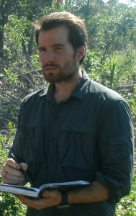
Benjamin Trumble
Assistant Professor
School of Human Evolution & Social Change
Current research
Using field and lab studies to examine how environmental conditions (parasites, diet, physical activity) impact chronic diseases of aging like Alzheimer's Dementia and Cardiovascular Disease

Slide 17
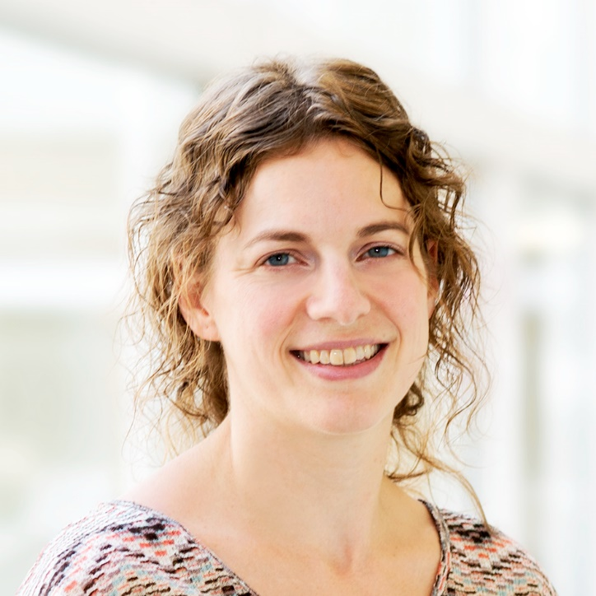
Silvie Huijben
Assistant Professor
Center for Evolution and Medicine
Current Research
Evolution of drug resistance in general and in the context of malaria in particular. Understanding which factors are involved in driving resistance through the population and how they can be utilized this knowledge to maximize the useful life span of drugs and insecticides.

Slide 18
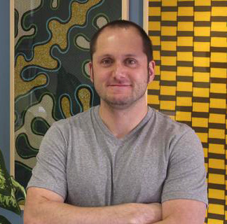
Krijn Paaijmans
Assistant Professor
Center for Evolution and Medicine
Current research
Anopheline mosquitoes and the malaria parasites they transmit. Integrating laboratory experiments, field experiments and mathematical models to better inform current malaria control and elimination programs and to help developing appropriate adaptation or mitigation strategies for future climates.

Slide 19
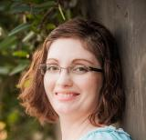
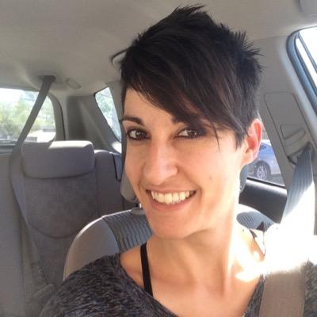
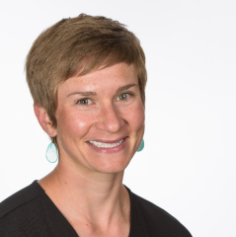
Postdocs
Angela Bond
Postdoctoral Research Associate
Development of the microbiome of the infant, immunological responses from the parent and infant, impacts of non-parental human milk on development of the immune response and microbiome.
Hallie Edmonds
Postdoctoral Research Associate
Studies feeding biomechanics and anatomy.
Alexandra Greenwald
Postdoctoral Fellow
Evolutionary anthropology, bioarchaeology, archaeometry, breastfeeding and early childhood diet, maternal and infant health, hunter-gatherers, behavioral ecology, life history, reproductive ecology, maternal time allocation, child foraging, diet

Slide 20
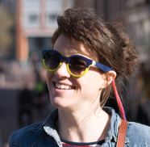
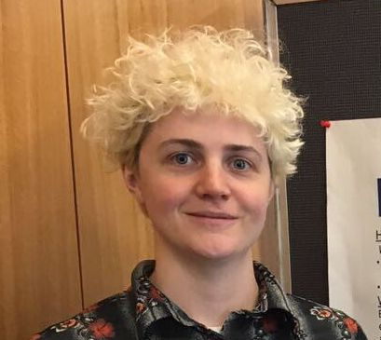
Postdocs
Dan Grunspan
Postdoctoral Research Associate
Research on evolution education strategies, and assisting with development of online educational resources and CEM degrees
Rebecca Harris
Postdoctoral Research Associate
Interested in evolutionary biology with an emphasis on phylogenetic systematics and the evolution of traits in avian systems.
Caley Johnson
Associate Research Professional
Her research focuses on nutritional ecology - how primates meet their nutritional needs through complex methods of foraging in variable environments. The goal of this research is to inform the management and protection of primates and their habitats.

Slide 21
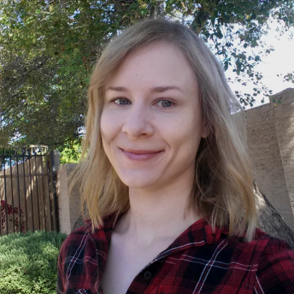
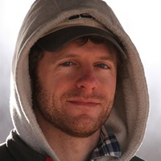
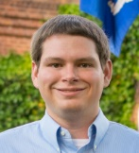
Postdocs
Heini Natri
Postdoctoral Research Fellow
Uses a systems genetic approach to investigate tumor evolution, sex bias in cancer occurrence, and the genomic architecture of cancer.
Andrew Ozga
Postdoctoral Research Fellow
Interested in the impact of environment and diet on the primate and non-human microbiome and virome through time and space.
Andrew Sackman
Postdoctoral Research Associate
Gene interactions and compensatory evolution in phages. Novel statistical method development, as well as a continued focus on the analysis of experimental evolution data

Slide 22
Affiliated Faculty
Michael Barton
Professor
School of Human Evolution and Social Change
James Collins
Virginia M. Ullman Professor
School of Life Sciences
Amy Boddy
Assistant Research Professor
The Biodesign Institute
Sudhindra R. Gadagkar
Associate Professor
Midwestern University
Alex Brewis Slade
Director and Professor
School of Human Evolution and Social Change
Jürgen Gadau
Professor
University of Münster
Reed Cartwright
Assistant Professor
School of Life Sciences
Ian Gilby
Assistant Professor
School of Human Evolution and Social Change

Slide 23
Affiliated Faculty
Jon Harrison
Professor
School of Life Sciences
Bertram Jacobs
Director, School of Life Sciences; Professor
School of Life Sciences
Kim Hill
Professor
School of Human Evolution and Social Change
Douglas Kenrick
Professor
Department of Psychology
Daniel Hruschka
Associate Professor
School of Human Evolution and Social Change
William Kimbel
Center Director and Professor
School of Human Evolution and Social Change and The Institute of Human Origins
Bruce Kaplan
Professor of Medicine, Mayo Clinic
Professor in School for the Science of Health Care Delivery
Kevin Langergraber
Assistant Professor
School of Human Evolution and Social Change

Slide 24
Affiliated Faculty
Jane Maienschein
Regents', President's, and Parents Association Professor
School of Life Sciences
Kaye Reed
President's Professor
School of Human Evolution and Social Change
Sarah Mathew
Assistant Professor
School of Human Evolution and Social Change
Gary Schwartz
Associate Professor
School of Human Evolution and Social Change
Steven Neuberg
Professor
Department of Psychology
Joan Silk
Professor
School of Human Evolution and Social Change
Susanne Pfeifer
Assistant Professor
School of Life Sciences
Brian Smith
Professor
School of Life Sciences

Slide 25
Affiliated Faculty
Cynthia Stonnington
Chair, Psychiatry and Psychology
The Mayo Clinic
Arvind Varsani
Associate Professor
The Biodesign Institute, Fundamental and Applied Microbiomics
Amber Wutich
Associate Professor
The School of Human Evolution and Social Change

Slide 26
Affiliated units at ASU
Biodesign Institute
School of Life Sciences
School of Human Evolution & Social Change
Department of Psychology
College of Health Solutions
Institute for Human Origins
Biosocial Complexity Initiative
Adaptation, Culture Behavior and Society
Obesity Solutions
Notes:
Hide?

Slide 27
Alliances
International Society for Evolution, Medicine & Public Health
Mayo Clinic and Hospitals
Banner University Hospitals
Midwestern Medical School
TriCEM at Duke
University of Zurich Center for Evolutionary Medicine
CARTA at UCSD

Slide 28
Accomplishments
CEM Venture Fund providing funding for multiple ASU projects
Four faulty recruited
Three education post docs recruited
CEM Blog - featuring posts on current topics in EvMed by CEM faculty.
EvMedEd.org launched as the world’s online resource for EvMed education
100+ videos created from seminars and events and available online
30+ in-depth interviews with scholars being edited and posted to YouTube
Created the EvMedNetwork with 700+ scientists, teachers, and students
Founded the International Society for Evolution, Medicine & Public Health
Notes:
Update

Slide 29
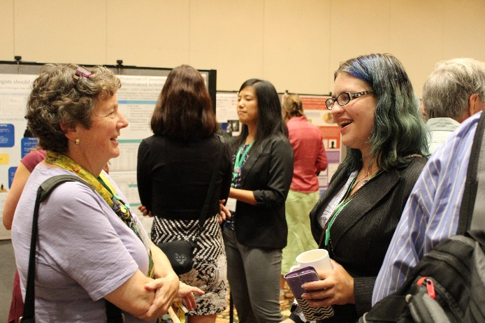
The International Society for Evolution, Medicine & Public Health (ISEMPH)
Founding this Society has been essential for the field and has brought ASU recognition as the world leader
700+ members in the EvMed Network, 240 paid members of the Society
Meeting at Duke University this year was very successful
2017 meeting with European Society for Evolutionary Biology in Groningen, Netherlands
2018 meeting confirmed in Utah
2019 meeting confirmed in Zurich

Slide 30
Web Development Projects
EvMedEd.org
is a curated collection of education resources for evolutionary medicine including books, videos, websites and syllabi. It is sponsored by ISEMPH and the Center for Evolution & Medicine at ASU.
The Center also helps maintain EvMedReview.com, the field’s nexus for news and opinion.

Slide 31
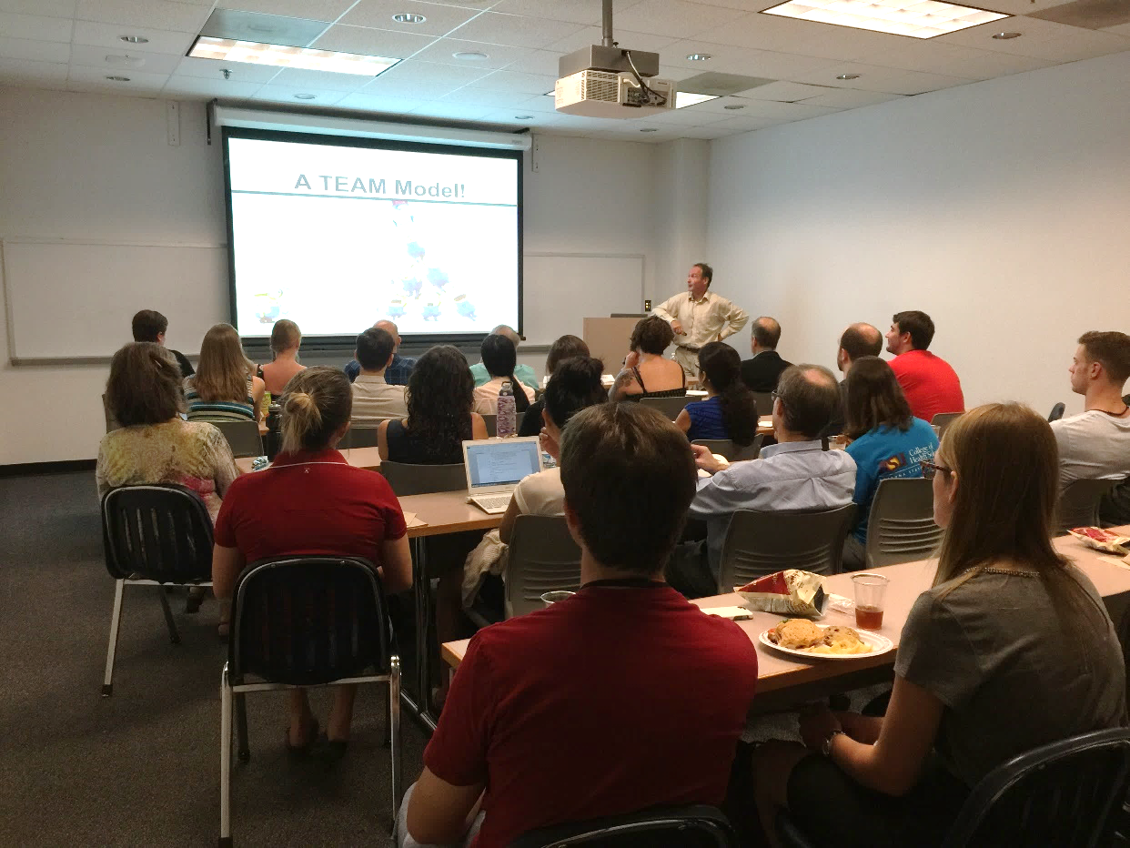
Next Steps
Master’s Degree is a priority, probably with Global Health SOLS/SHESC
Undergrad concentration and PhD programs await more faculty and courses
Online courses under construction
Resources for doctors and Mayo students in development

Slide 32
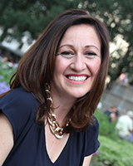
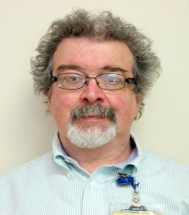
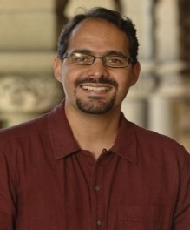
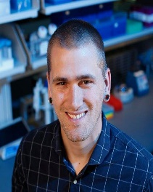
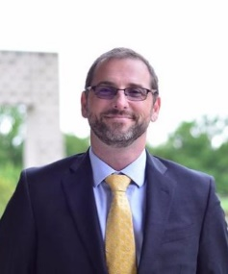
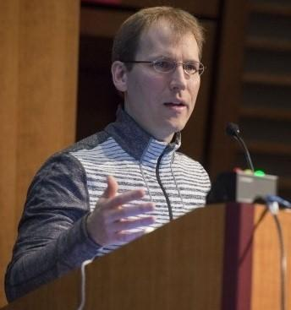
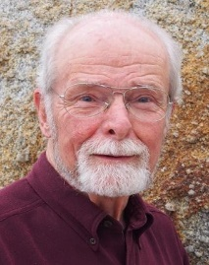
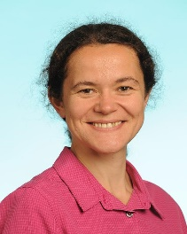
Spring 2018 Seminars
January 23
Montserrat Anguera
University of Pennsylvania
April 19
Andres Moreno Estrada
National Laboratory of Genomics for Biodiversity
March 1
Israel Liberzon
University of Michigan
February 15
Nicholas Banovich
Translational Genomics Research Institute
March 22
Cecil M.Lewis, Jr.
University of Oklahoma
April 26
Jens Kuhn
Fort Detrick
February 22
George Somero
Stanford University
April 12
Mihaela Pavlicev
University of Cincinnati
Thursdays at 12pm in LSC 202
Visit evmed.asu.edu to RSVP
Videos of past talks can also be
found at evmed.asu.edu
Notes:
Cladogram in white empty space, stetho

Slide 33
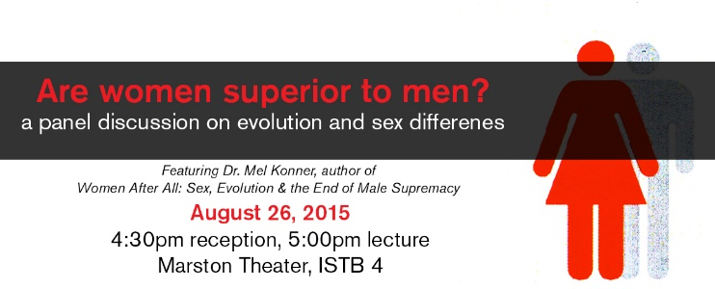
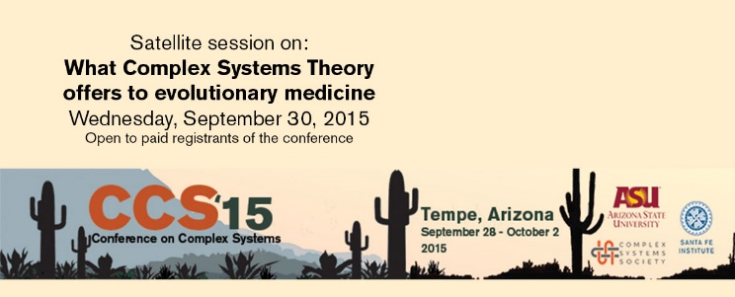
Past Major Events
Symposium on Evolution and Global Health for The Lancet. October 2014
Are women superior to men? A panel discussion on evolution and sex differences, featuring Mel Konner and Sarah Hrdy. August 2015
Conference on Complex Systems 2015 Symposium: What Complex Systems Theory offers to Evolutionary Medicine. September 2015
Steven Austad on Aging, a workshop in February 2016.
Darwin Day featuring Lee Dugatkin, The Evolution of Goodness, Justice, and Empathy. February 2016
American Association for the Advancement of Science (AAAS) Meeting Symposium: Evolutionary Biology Impacts on Medicine and Public Health. February 2016. Held in Washington, D.C.
Notes:
Hide

Slide 34
Past Major Events (contd.)
Darwin Day featuring Barbara Natterson-Horowitz, Not Uniquely Human February 2017
Symposium on Evolutionary medicine and complex adaptive systems. February 2017
Notes:
Hide

Slide 35
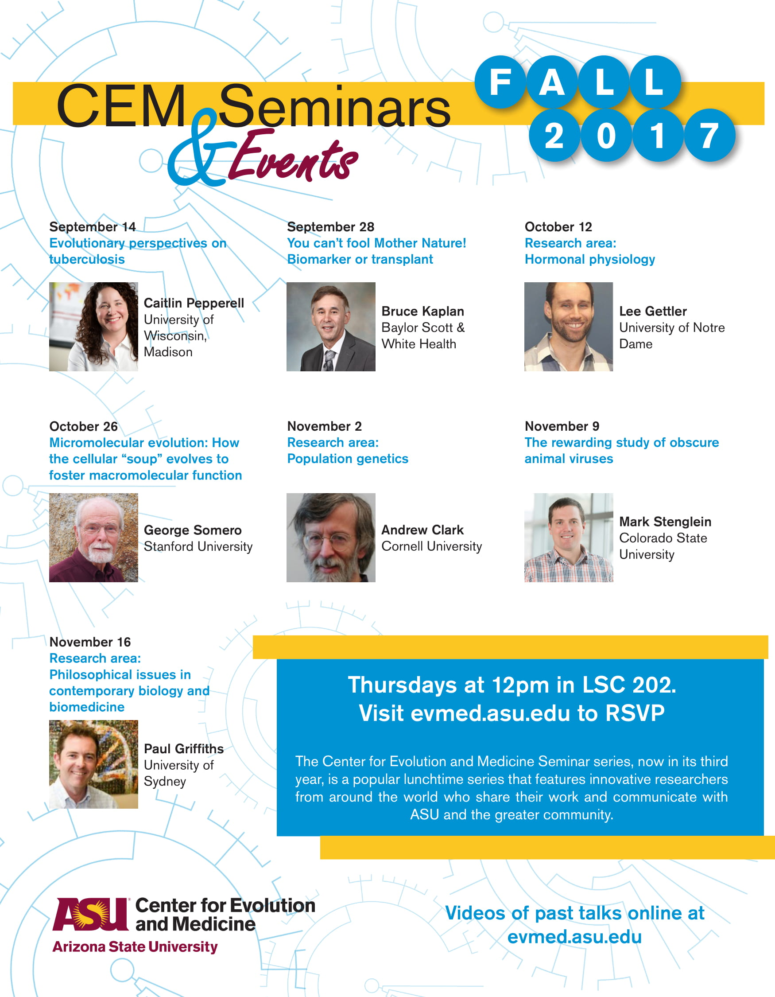
Fall 2017
CEM hosted 7 seminar speakers in Fall 2017
The third annual ISEMPH meeting was held in Groningen, The Netherlands
Notes:
Hide

Slide 36
Sign up for our newsletter and stay up-to-date with news and events evmed.asu.edu

